Slide 1
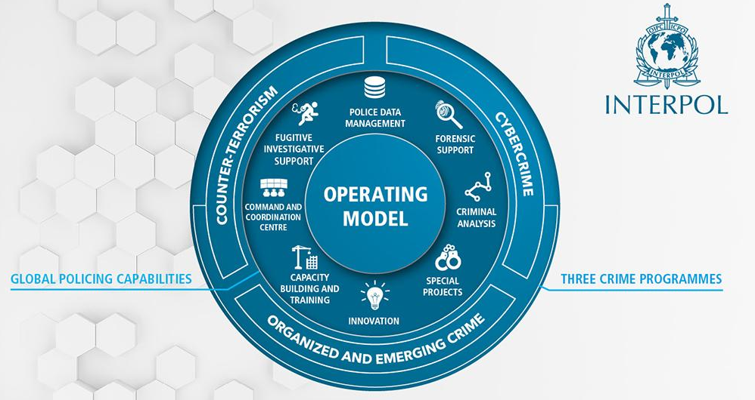

INTERNATIONAL ORGANIZATIONS
INTERPOL
International Criminal Police Organization.
-Founded on 7Th Sept 1923 at Vienna
-HQ : Lyon, France.
-195 members state.
Shubham Sangwan Research Scholar
National Forensic Sciences University

Slide 2
INTERPOL
Structure
General Assembly : INTERPOL’S supreme governing body, it meets annually and comprises delegates appointed by each member country. The assembly takes all important decisions related to Policy, resources, working methods, finances, activities and programs.
Executive Committee : This 13-members committee is elected by the GA, and comprises the President (4 years), Three Vice-President and Nine Delegates (3 years) covering the four regions.

Slide 3
INTERPOL
Interpol provides investigative support, expertise, and training to law enforcement worldwide, focusing on three major areas of transnational crime: terrorism, cybercrime, and organized crime.
Its broad mandate covers virtually every kind of crime, including crimes against humanity, child pornography, drug trafficking and production, political corruption, intellectual property infringement, and white-collar crime.
The agency also facilitates cooperation among national law enforcement institutions through criminal databases and communications networks. Contrary to popular belief, Interpol is itself not a law enforcement agency.

Slide 4
INTERPOL
Salient features:
They manage 19 police databases with information on crimes and criminals, accessible in real-time to countries.
An INTERPOL Incident Response Team can be briefed, equipped and deployed anywhere in the world within 12 to 24 hours.
ID-ART is an innovative tool to counter the threat, available publicly, the app provides real-time access to the INTERPOL database of stolen works of art, and has already contributed to the recovery of stolen works.
I-Familia is a global database for identifying missing persons based on international DNA kinship matching. The result of cutting-edge scientific research, the database seeks to identify missing persons or unidentified human remains when direct comparison is not possible, by using DNA samples from family members instead.

Slide 5
NOTICES
WANTED PERSONS
INTERPOL Notices are international requests for cooperation or alerts allowing police in member countries to share critical crime-related information.
Notices are issued by the General Secretariat at the request of a member country’s INTERPOL National Central Bureau and are made available for all our member countries to consult in our Notices database.
MISSING PERSONS
ADDITIONAL INFORMATION
UNIDENTIFIED BODIES
WARNING AND INTELLIGENCE
IMMINENT THREAT
MODUS OPERANDI

Slide 6
INTERPOL
Red Notice: To seek the location and arrest of persons wanted for prosecution or to serve a sentence.
Yellow Notice: To help locate missing persons, often minors, or to help identify persons who are unable to identify themselves.
Blue Notice: To collect additional information about a person’s identity, location or activities in relation to a criminal investigation.
Black Notice: To seek information on unidentified bodies.
Green Notice: To provide warning about a person’s criminal activities, where the person is considered to be a possible threat to public safety.
Orange Notice: To warn of an event, a person, an object or a process representing a serious and imminent threat to public safety.
Purple Notice: To seek or provide information on modus operandi, objects, devices and concealment methods used by criminals.
INTERPOL–United Nations Security Council Special Notice: Issued for entities and individuals who are the targets of UN Security Council Sanctions Committees

